Slide 1

reImagine Technologies
David Moreno
Mario Raushel
Terence Sin
Caleb Wells

Slide 2

Contents
Background
Requirements
Design
System
Demonstration
Team Management and Teamwork
Concerns
Final Product

Slide 3
Background
Needs
  There is a need for users to autonomously create and explore daily photo life logs for both a fun and interesting experience.
Problem
  Create log of your daily movement
  Visualize day through captured images
Goal
  The goal for this project is to create a wearable camera system capable of recording GPS data that will automatically record the daily life of the user based on a variety of triggers, and organize data.

Slide 4
Requirements
The prototype design should cost no more than $500
The prototype must be battery powered and capable of logging a 12 hour session
The camera unit should not cause any harm to the user or others
The camera should function well both indoors and outdoors

Slide 5
Requirements
The GPS should function well in outdoor urban areas and have a decent failover for loss of signal indoors
The design must be comfortable to wear and lightweight (< 1 lb)
Accompanying software must be easy to use and understand
The camera unit must take good quality pictures (at least 320 x 240 resolution)

Slide 6
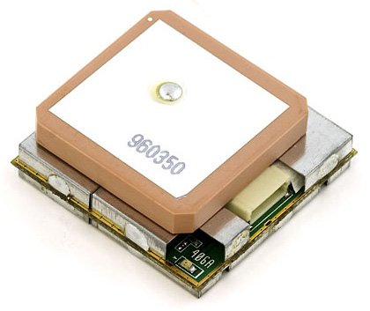
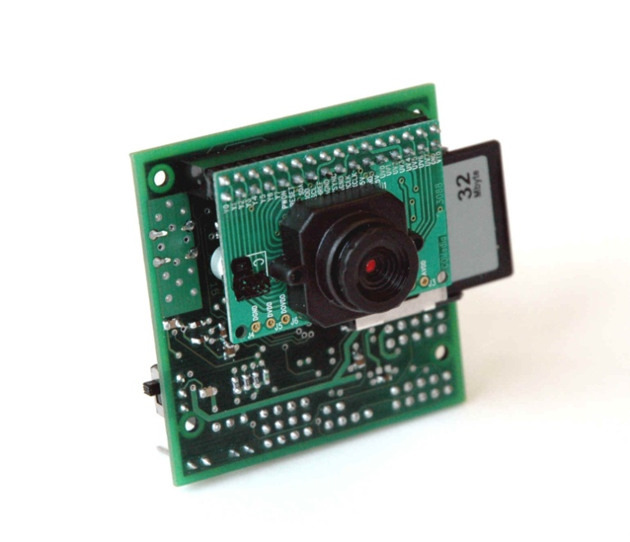
Components
GPS
  EM-406A SiRF III Receiver
Camera
  CMUCam3

Slide 7
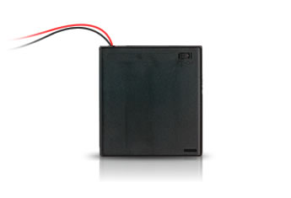
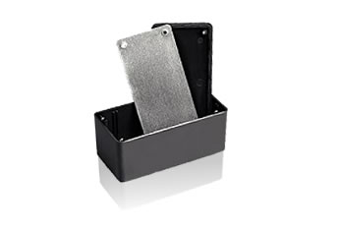
Components
Power
  4AA Batteries
Enclosure
  5x2.5x2 Project Box

Slide 8
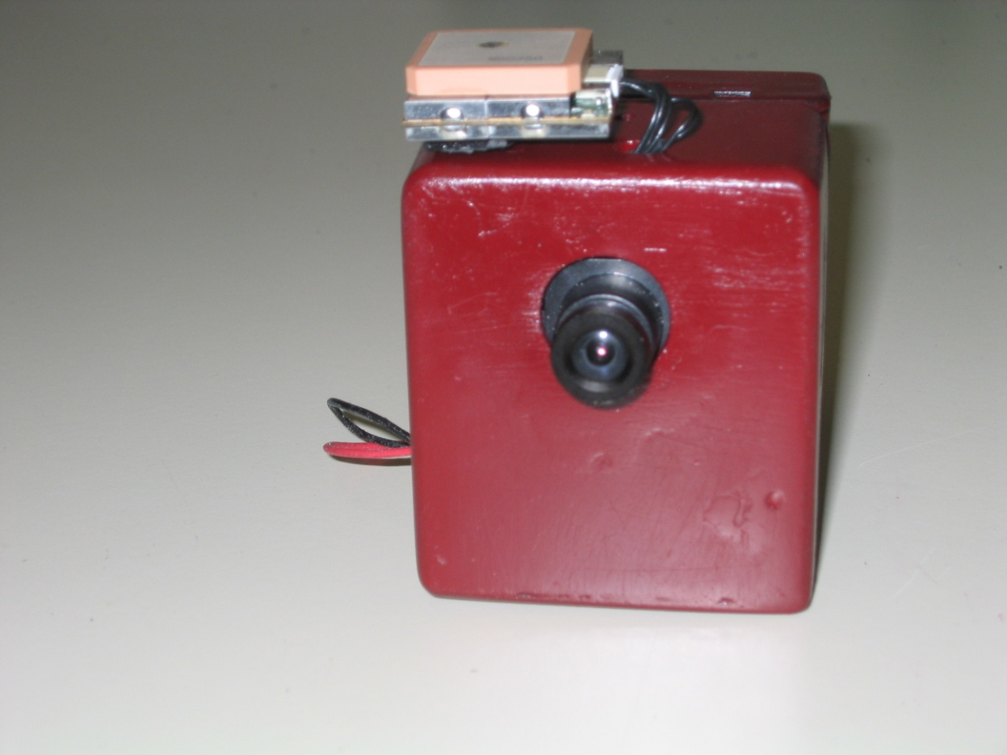
Enclosure Design
Final dimensions: 2.75”x2.5”x1.5”

Slide 9
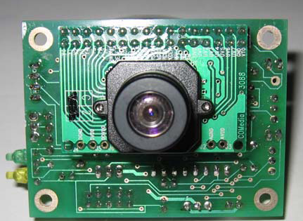
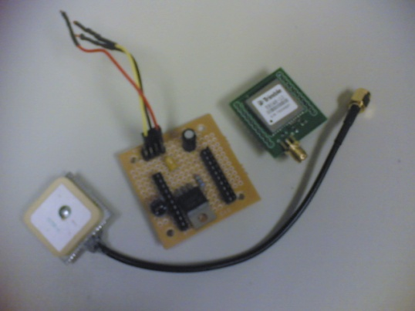

Design Alternatives
Camera
  AVRCam
  CMUCam2
GPS
  Trimble Copernicus
  SiRF II
Enclosure Designs
  Custom Acrylic
  Aluminum Project Box
Web Services
  Flickr

Slide 10
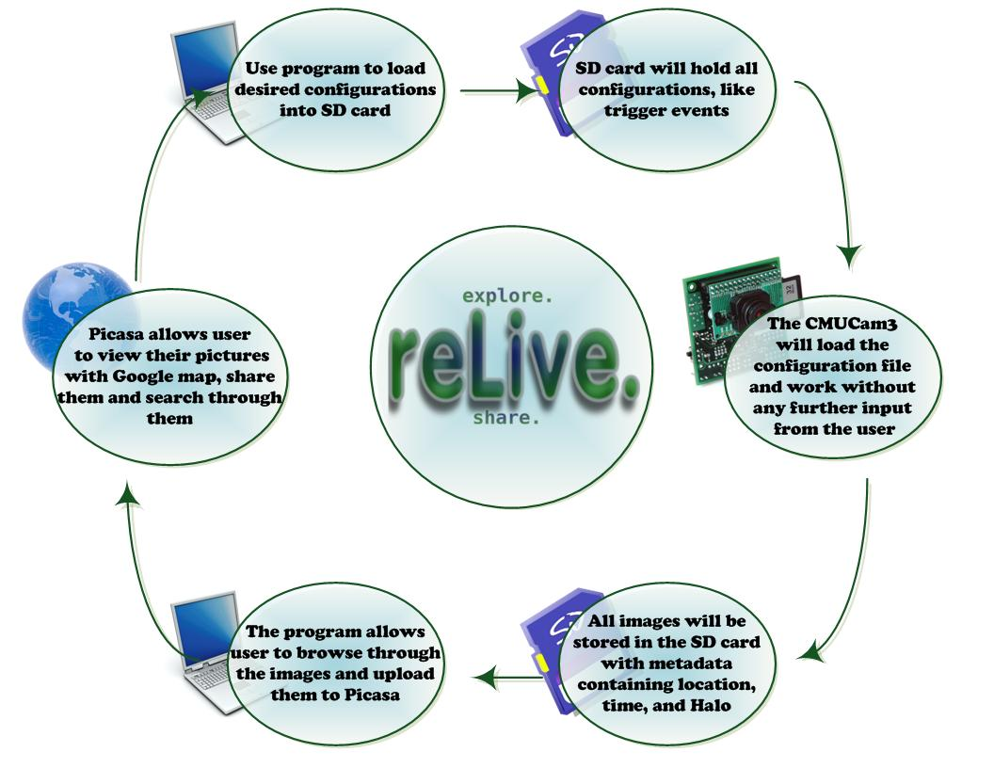

Slide 11
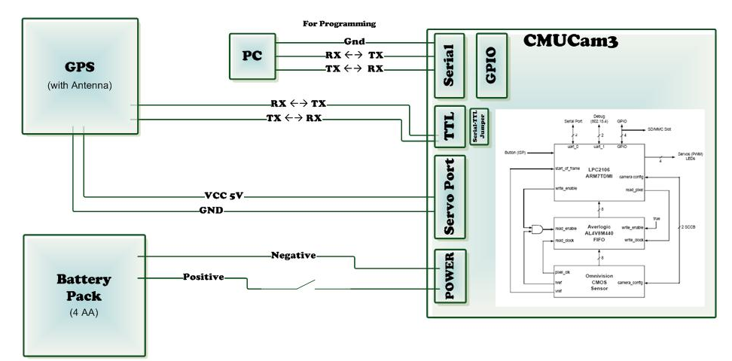
Hardware Design

Slide 12
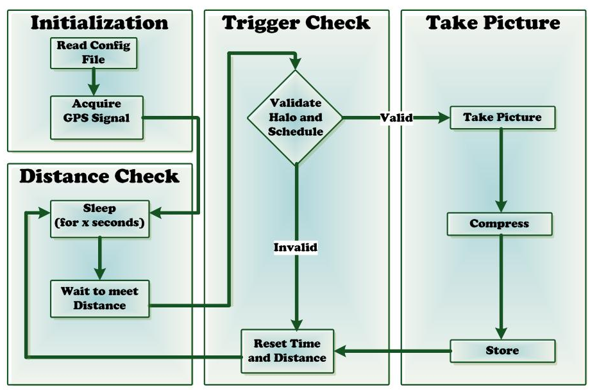
CMUCam3 Program Design

Slide 13
Trigger Settings
Time Delay (Minutes) - The amount of time the camera must wait between each picture taken
Minimum Distance - The distance a user must travel before another picture is taken.
Scheduler – Times during which pictures should be taken.
Location Halo - The center and radius of a halo where pictures must be taken.

Slide 14
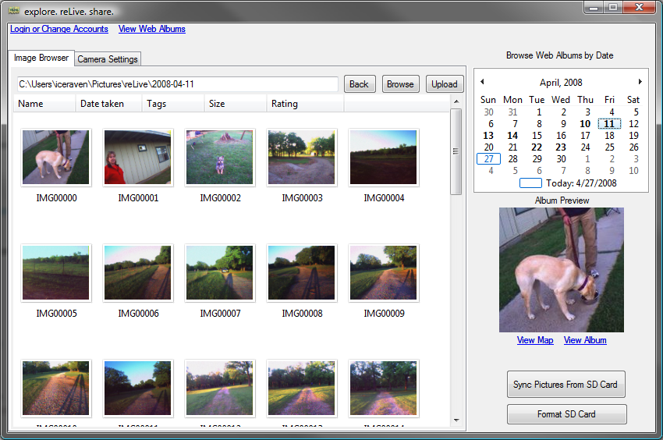
Software Demo

Slide 15
Team Management
David Moreno
  Hardware and CMUCam3 operations
  Purchasing
Mario Raushel
  Software design and implementation
Terence Sin
  Software and hardware interaction design
Caleb Wells
  Leader
  Hardware and GPS operations
  Enclosure Design

Slide 16
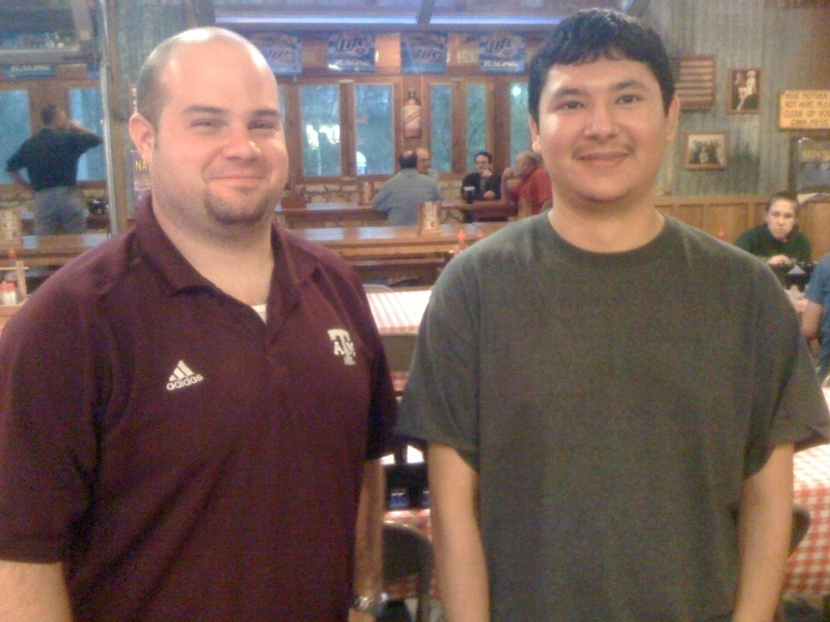
Effective Teamwork
2-3 meetings each week to discuss updates and plans
Bi-weekly email communication providing individual progress reports
Team building activities such as meeting at Rudy’s for dinner
Overcame problems as a team

Slide 17
Societal, Safety, Political, and Environmental Analysis
Societal Analysis
  For privacy concerns the camera must be large enough that others can tell they are being photographed
Safety Analysis
  Used non-conductive enclosure
  Used NiMH batteries instead of Li-ION
Political Analysis
  Each time the software is run, the user must agree not to use the device for malicious or illegal reasons.
Environmental Analysis
  Will be supplied with rechargeable , recyclable batteries
  Lead free device

Slide 18
Manufacturability, Sustainability and Economics
Manufacturability
  Hardware easily mass produced
  Software easily distributed
  Programmed on CMUcam3
Sustainability
  AA Batteries can be recharged or replaced
  Information synchronized to both computer and Google
Economics
  Low bulk material cost
  CMUcam3 is licensed to distributers

Slide 19
Final Product
Budget
  CMUcam3 $239.00
  EM-406A SiRF III GPS Unit $88.24
  Enclosure $3.69
  Battery Pack $1.99
  4x AA Rechargeable Batteries $10.00
  Epoxy $3.00
  Various Connectors $6.00
  1Gb SD Card $15.00
  Total for Unit $366.92

Slide 20
Evaluation Results
Test Runs
  Tested Halo, Distance, Schedule in different runs.
Battery Life
  The battery lasted 15 hrs when configured to take a picture every 1 min and 30 sec.
Usability
  Had unfamiliar users test program

Slide 21
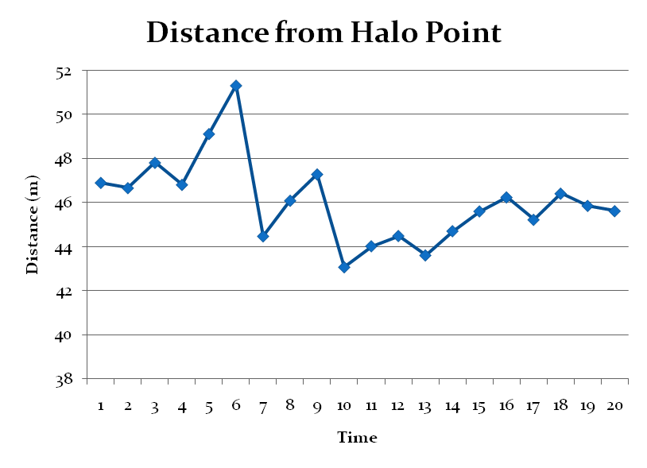
Evaluation Results
Accuracy Test
MAX | 51.327
MIN | 43.08
MEDIAN | 45.9835
MEAN | 46.07655
Max - Min | 8.247
Max - Mean | 5.25045
Mean - Min | 2.99655

Slide 22
Overview
Background
Requirements
Design
System
Demonstration
Team Management and Teamwork
Concerns
Final Product

Slide 23
Any Questions?

